Slide 1
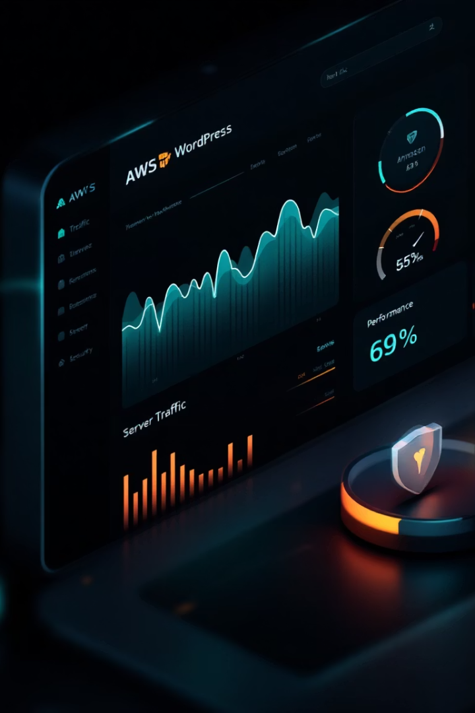

Evaluating WordPress Deployment on AWS: A Full-Stack CMS Implementation
A technical exploration of enterprise-level WordPress deployment using Amazon Web Services infrastructure and best practices.
by Abdirahman1 Ahmed

Slide 2

Project Scenario
The Challenge
The Question
Businesses require scalable, secure content management systems. Traditional solutions often fall short.
WordPress dominates the CMS market. But is it truly viable for enterprise deployment?
The Approach
We'll evaluate a WordPress AWS implementation against enterprise requirements.

Slide 3





High-Level Solution Overview
Apache Web Server
Handles HTTP requests and serves WordPress files
MariaDB Database
Stores WordPress content, user data, and settings
Amazon EC2
Provides virtualized compute infrastructure
Security Groups
Implements tiered security controls

Slide 4
Technology Breakdown - Linux
Chosen: Amazon Linux 2023
Alternatives
Optimized specifically for AWS environments
Ubuntu: Larger community support
Lightweight with enhanced security features
CentOS: Enterprise stability
Regular security updates from Amazon
Amazon Linux has less community support than Ubuntu.

Slide 5




Technology Breakdown - Web Servers
Easy WordPress Integration
Extensive Documentation
Apache's .htaccess support simplifies WordPress configuration and URL rewriting.
Mature documentation ecosystem supports troubleshooting and optimization.
Resource Consideration
Can consume more resources than NGINX under heavy traffic loads.

Slide 6
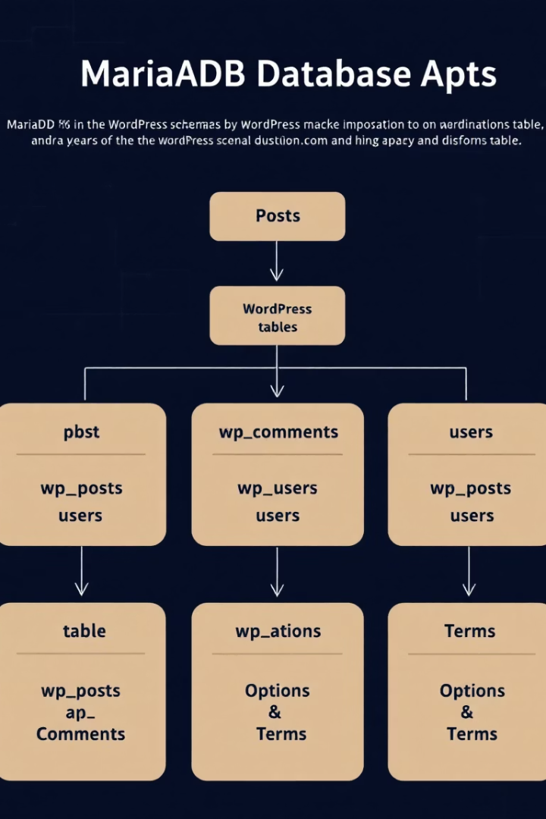



Technology Breakdown - Databases
MySQL Compatibility
Direct fork of MySQL ensures perfect WordPress compatibility.
Open Source Development
Fully open development model promotes security and innovation.
Support Considerations
Less enterprise support compared to Oracle MySQL.

Slide 7








Technology Breakdown - Virtualization
Elastic Scaling
Built-in Monitoring
Dynamically adjust resources based on traffic demands
CloudWatch integration provides comprehensive performance visibility
Cost Efficiency
Network Complexity
T3a.nano offers balanced performance/cost ratio
Requires understanding of VPC, subnets, and routing

Slide 8






Technology Breakdown - CMS
User-Friendly Interface
Intuitive administration requires minimal training
Extensive Plugin Ecosystem
Over 59,000 plugins provide virtually unlimited functionality
Performance Considerations
May require caching/CDN for enterprise-scale traffic

Slide 9





Key Advantages & Challenges
Deployment Speed
Customization
Cost-Effective
Security Concerns
Thousands of themes and plugins enable unique solutions.
Ideal for small/medium businesses with limited budgets.
Rapid setup and configuration reduce time-to-market.
Third-party plugins introduce potential vulnerabilities.

Slide 10

Conclusion & Next Steps
Implement Security Hardening
Apply WordPress security best practices and implement WAF protection.
Performance Optimization
Add caching layers and consider CDN integration for global audiences.
Monitoring & Maintenance
Establish automated backup routines and update management procedures.
Documentation & Training
Create operational runbooks and conduct admin training sessions.

